Slide 1
On the Design and Chosen IV Statistical Cryptanalysis of Lightweight Stream Ciphers
In the Name of God
Vahid Amin-Ghafari
vahidaming@ustc.edu.cn

Slide 2
Introduction
Information security is very important section of technology.
Cryptography is the basis of information security.
Stream cipher is a section of symmetric-key (private key) cryptography.
Thesis on two parts:
Cryptanalysis of Lightweight Stream Ciphers
Proposed attack is the best practical attack on ACORN-v3 and can be the best one on Grain-128a
Design of Lightweight Stream Ciphers
Fruit-80 is the lightest in ASIC hardware implementation
Notes:
Our attack is the best
And our attack on Grain can be best attack in some applications.

Slide 3
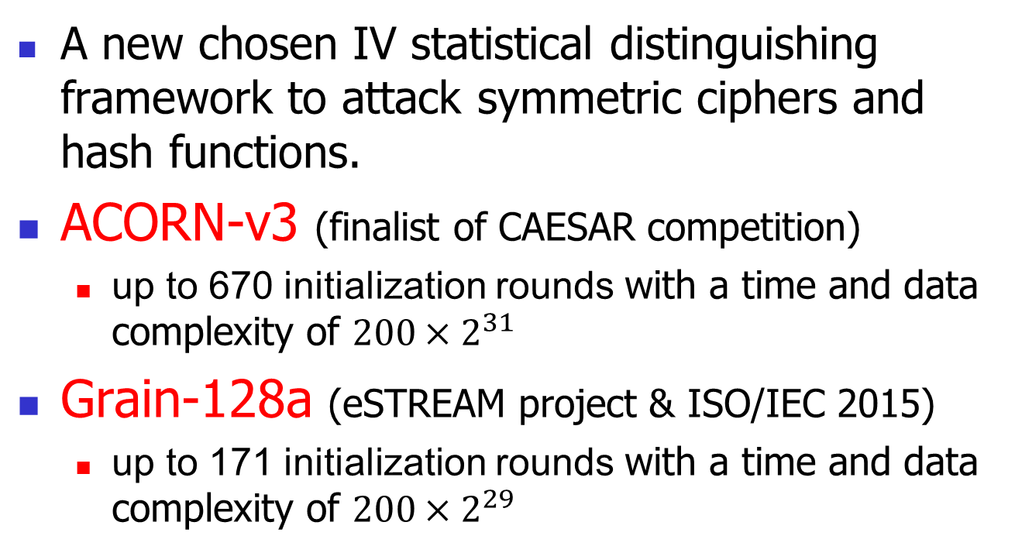
Analysis of Lightweight Stream Ciphers
A new chosen IV statistical distinguishing framework to attack symmetric ciphers and hash functions.
ACORN-v3 (finalist of CAESAR competition)
up to 670 initialization rounds with a time and data complexity of ${200×2}^{31}$
Grain-128a (eSTREAM project & ISO/IEC 2015)
up to 171 initialization rounds with a time and data complexity of ${200×2}^{29}$
Notes:
We proposed A new chosen IV
We discuss how it is possible to succeed in a distinguishing attack against up to 670 initialization rounds of ACORN-v3 and 171 initialization rounds of Grain-128a by our framework with time complexities of ${200×2}^{32}$ and ${200×2}^{29}$, respectively.
Authenticated Encryption
eSTREAM project and Grain-128a has been standardized for RFID devices (ISO/IEC 2015)

Slide 4
A new chosen IV statistical distinguishing framework
Better results can be achieved by more computational complexity (similar cube attacks).
The proposed attack is applicable to all symmetric ciphers and hash functions.
Framework upon cube testers and d-monomial tests.
It can reveal the weaknesses that are not possible to find by other statistical tests or d-monomial tests.
The attack was practically verified.
Notes:
Better results can be obtained
The attack implemented and was practically verified

Slide 5
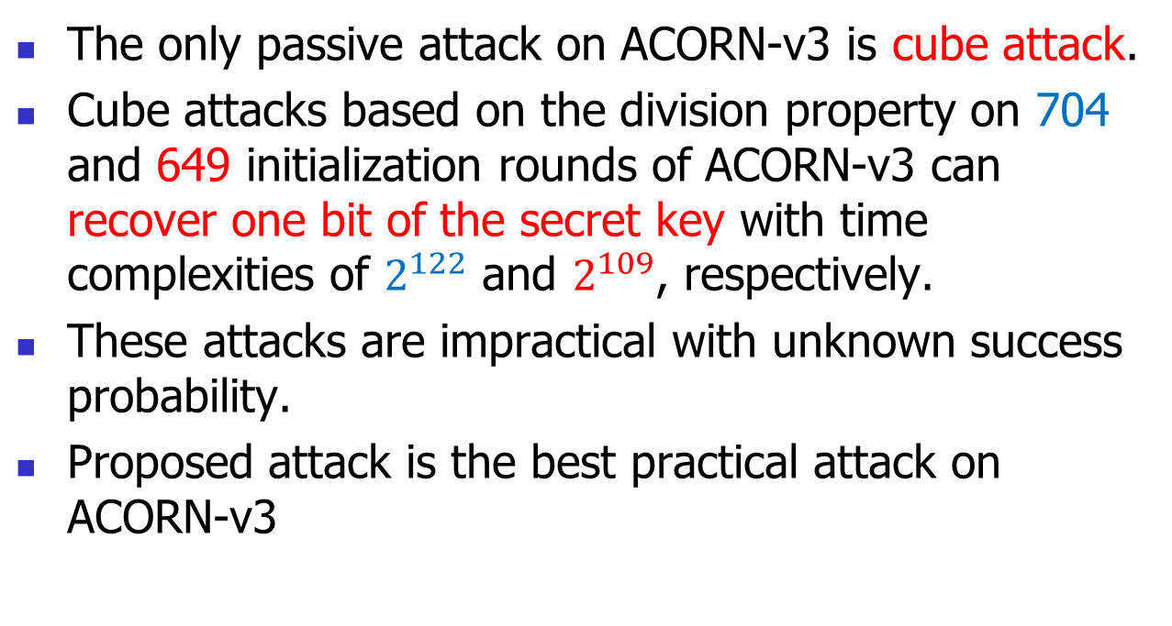
Previous attacks on ACORN-v3
The only passive attack on ACORN-v3 is cube attack.
Cube attacks based on the division property on 704 and 649 initialization rounds of ACORN-v3 can recover one bit of the secret key with time complexities of $2^{122}$ and $2^{109}$, respectively.
These attacks are impractical with unknown success probability.
Proposed attack is the best practical attack on ACORN-v3
Notes:
(because of the high time complexity)
The initialization of ACORN-128 consists of loading the key and IV into the state, and running the cipher for 1792 steps.

Slide 6
Previous attacks on Grain-128a
The only passive single-key attack on Grain-128a is the conditional differential attack on the reduced version.
In 2016, a conditional differential attack retrieves 18 secret key expressions for 169 initialization rounds on Grain-128a (conditions on IV),
and also a nonrandomness was presented for 195 initialization rounds in a chosen key/IV conditional differential attack scenario (weak-key setting).
Our attack can be the best attack on Grain-128a
Notes:
active fault attack (Banik et al. 2012) and related key chosen IV attack (Ding and Guanet 2013;Banik et al. 2013
but Grain-128a is considered secure from the practical point of view.
And our attack on Grain can be best attack in some applications. Because there is not any force on IV or Key in our attack.

Slide 7
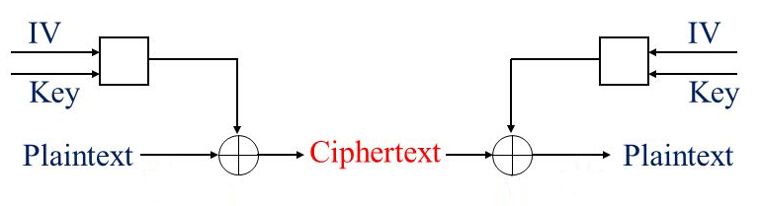
Stream ciphers
Stream ciphers
We suppose that ciphers are a black box with two inputs (i.e. key and IV) and one output (i.e. keystream).
There is a Boolean function from inputs to the first bit of the output.
Notes:
General Block Diagram

Slide 8
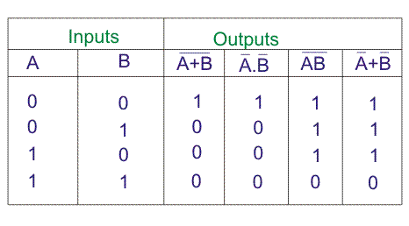
A new chosen IV statistical distinguishing framework
There is a truth table for Boolean function of the first bit of keystream.
The truth table outputs are composed of 2^n bits for every Boolean function in n variables.
A toy example.
Notes:
We consider the Boolean functions

Slide 9
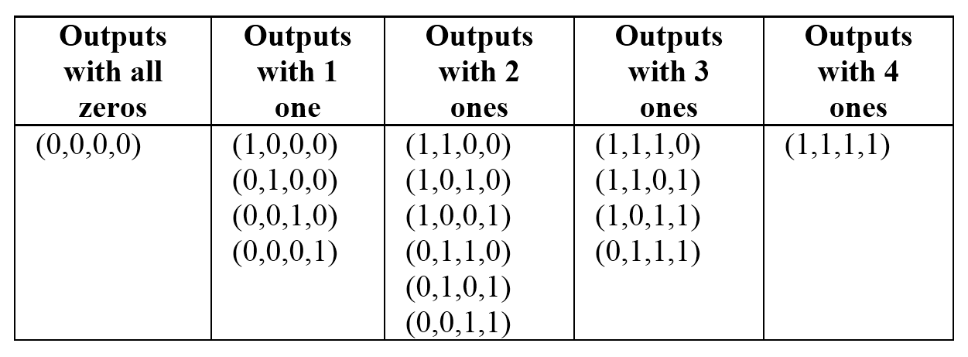
A new chosen IV statistical distinguishing framework
We consider the numbers of truth table with 4 ones, 3 ones, 2 ones, 1 one and all zeros
The grouping of the 16 random Boolean functions in 2 variables based on the number of ones in TT
Notes:
We expect that in a set of 16 random Boolean functions in 2 variables, there should exist approximately one function with all zeros, four functions with 1 one, six functions with 2 ones, four functions with 3 ones, an We obtain the TT for two bits of the IV while other IV and secret key bits are fixed.

Slide 10
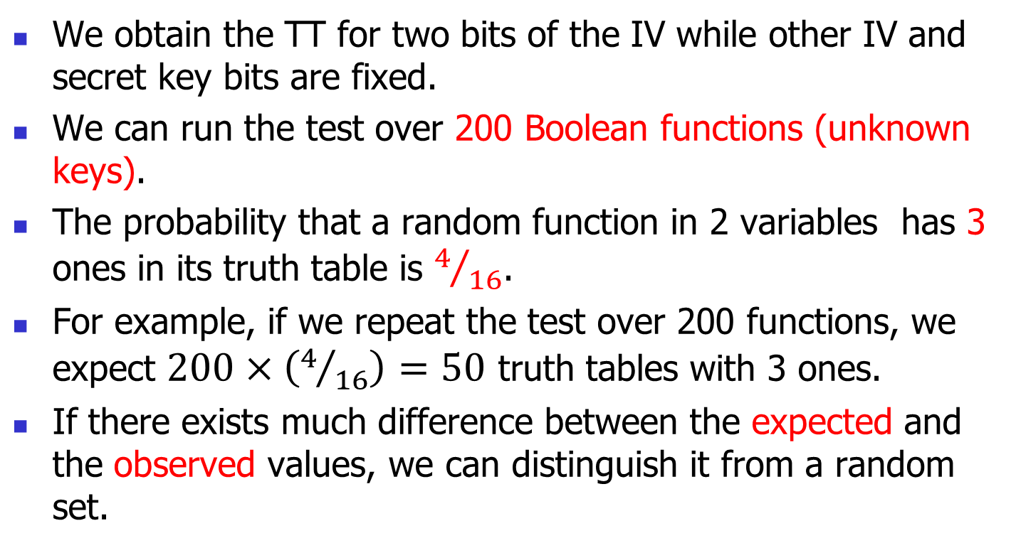
A new chosen IV statistical distinguishing framework
We obtain the TT for two bits of the IV while other IV and secret key bits are fixed.
We can run the test over 200 Boolean functions (unknown keys).
The probability that a random function in 2 variables has 3 ones in its truth table is $4/{16}$.
For example, if we repeat the test over 200 functions, we expect $200×\left(4/{16}\right)=50$ truth tables with 3 ones.
If there exists much difference between the expected and the observed values, we can distinguish it from a random set.

Slide 11
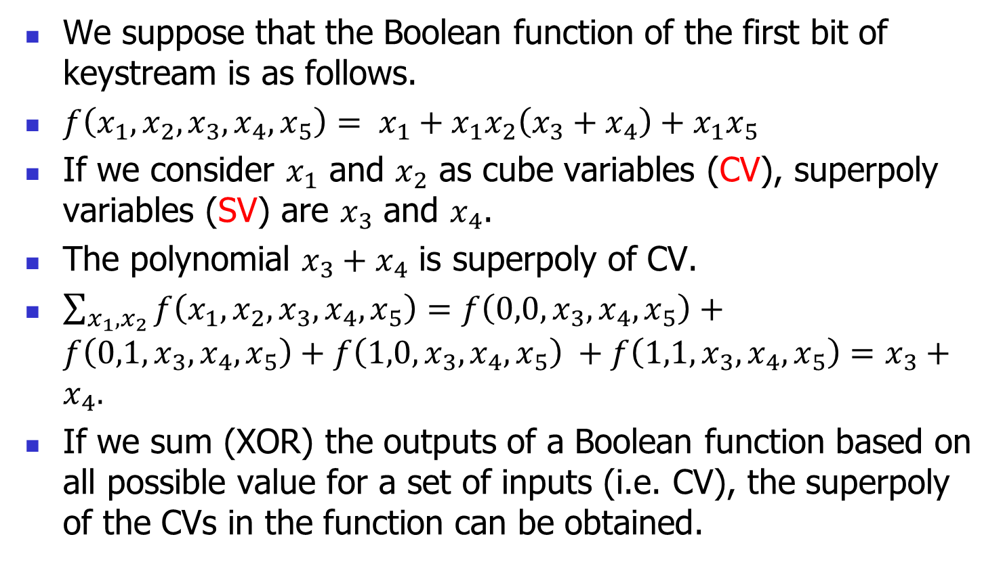
Background: Cube testers
We suppose that the Boolean function of the first bit of keystream is as follows.
$f\left(x_{1},x_{2},x_{3},x_{4},x_{5}\right)= x_{1}+x_{1}x_{2}\left(x_{3}+x_{4}\right)+x_{1}x_{5}$
If we consider $x_{1}$ and $x_{2}$ as cube variables (CV), superpoly variables (SV) are $x_{3}$ and $x_{4}$.
The polynomial $x_{3}+x_{4}$ is superpoly of CV.
$\sum_{x_{1},x_{2}}{f\left(x_{1},x_{2},x_{3},x_{4},x_{5}\right)}=f\left(0,0,x_{3},x_{4},x_{5}\right)+f\left(0,1,x_{3},x_{4},x_{5}\right)+f\left(1,0,x_{3},x_{4},x_{5}\right) +f\left(1,1,x_{3},x_{4},x_{5}\right)=x_{3}+x_{4}.$
If we sum (XOR) the outputs of a Boolean function based on all possible value for a set of inputs (i.e. CV), the superpoly of the CVs in the function can be obtained.

Slide 12
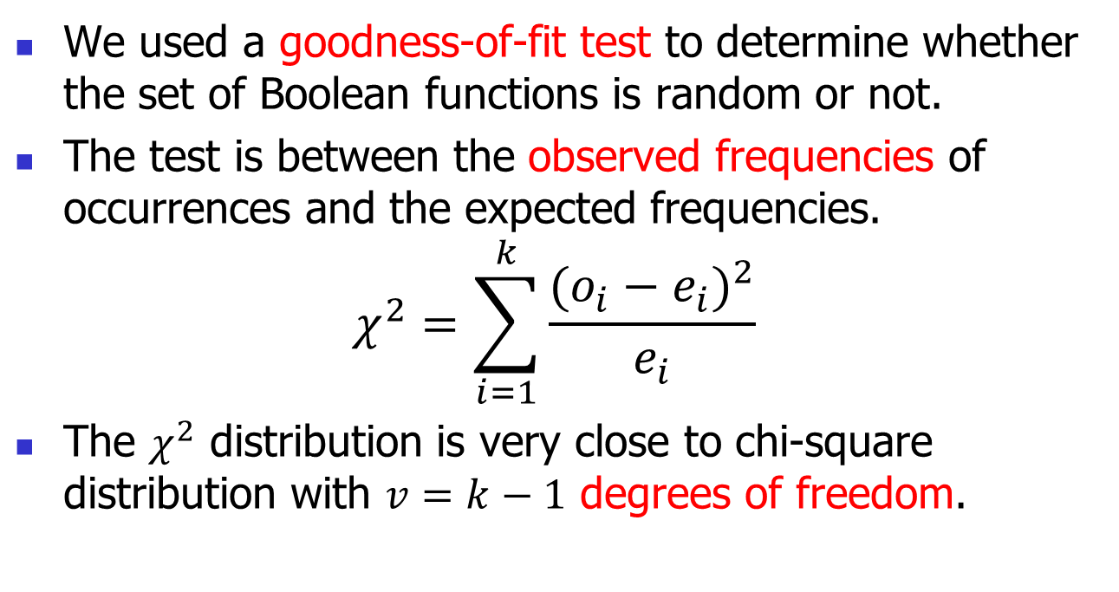
Background: Goodness-of-fit test
We used a goodness-of-fit test to determine whether the set of Boolean functions is random or not.
The test is between the observed frequencies of occurrences and the expected frequencies.
$$χ^{2}=\sum_{i=1}^{k}{\frac{{(o_{i}−e_{i})}^{2}}{e_{i}}}$$
The $χ^{2}$ distribution is very close to chi-square distribution with $v=k−1$ degrees of freedom.
Notes:
آزمون‌ نیکویی برازش

Slide 13
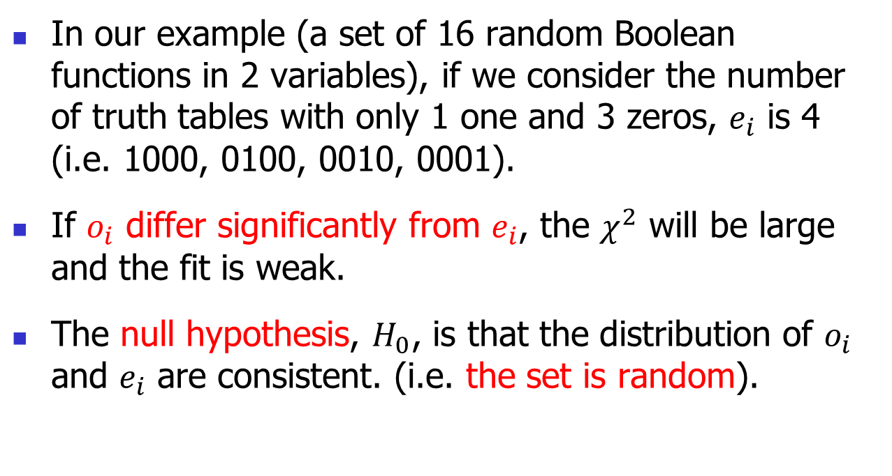
Background: Goodness-of-fit test
In our example (a set of 16 random Boolean functions in 2 variables), if we consider the number of truth tables with only 1 one and 3 zeros, $e_{i}$ is 4 (i.e. 1000, 0100, 0010, 0001).
If $o_{i}$ differ significantly from $e_{i}$, the $χ^{2}$ will be large and the fit is weak.
The null hypothesis, $H_{0}$, is that the distribution of $o_{i}$ and $e_{i}$ are consistent. (i.e. the set is random).
Notes:
فرض صفر

Slide 14
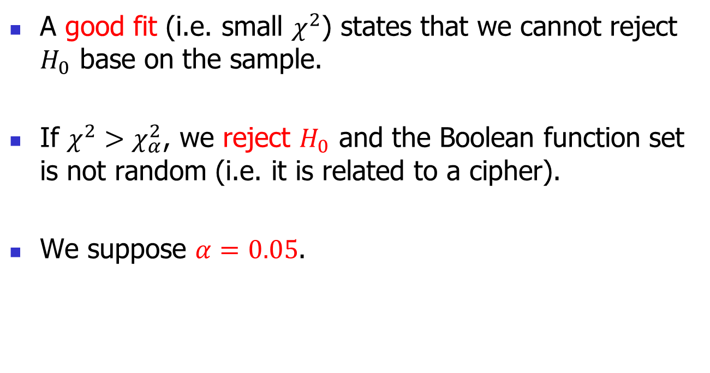
Background: Goodness-of-fit test
A good fit (i.e. small $χ^{2}$) states that we cannot reject $H_{0}$ base on the sample.
If $χ^{2}>χ_{α}^{2}$, we reject $H_{0}$ and the Boolean function set is not random (i.e. it is related to a cipher).
We suppose $α=0.05$.

Slide 15
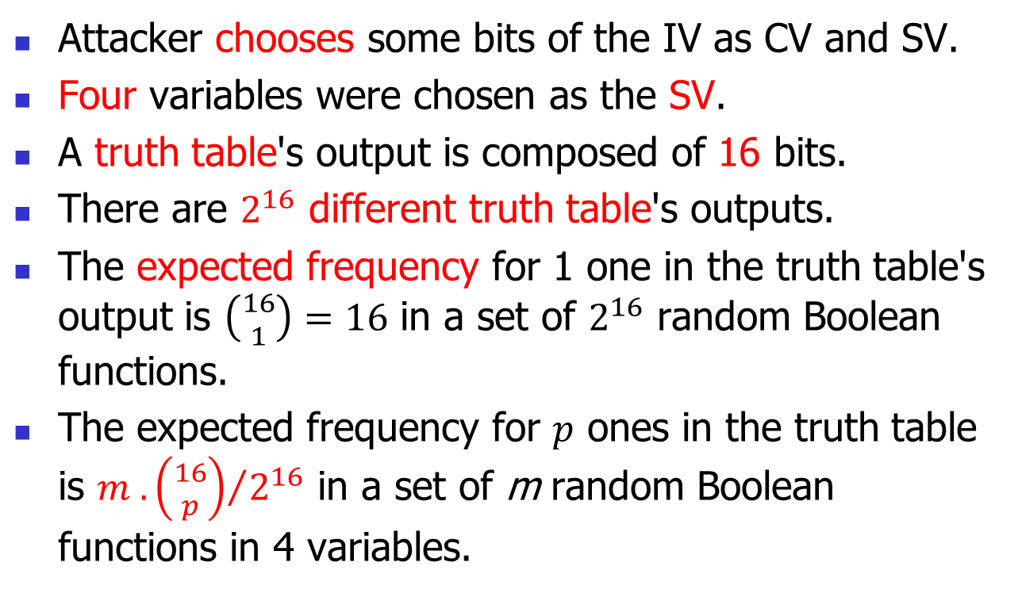
A new chosen IV statistical distinguishing framework
Attacker chooses some bits of the IV as CV and SV.
Four variables were chosen as the SV.
A truth table's output is composed of 16 bits.
There are $2^{16}$ different truth table's outputs.
The expected frequency for 1 one in the truth table's output is $\left({16 \atop 1}\right)=16$ in a set of $2^{16}$ random Boolean functions.
The expected frequency for $p$ ones in the truth table is ${m .\left({16 \atop p}\right)}/{2^{16}}$ in a set of m random Boolean functions in 4 variables.

Slide 16
A new chosen IV statistical distinguishing framework
Suppose that there are two resources that produce sequences: One is a cipher and other a random sequence generator. Attackers are interested in distinguishing between the sequences from the two resources. They can choose IV bits and obtain the first bits of the sequences. It is obvious that IV bits do not affect random sequence generators. We assume secret keys are random and unknown to the attackers.

Slide 17
A new chosen IV statistical distinguishing framework
He obtains the first bits of the keystreams with an unknown key.
He sums the first bits of the keystream over all possible CV and obtains superpoly of CV.
He obtains truth table of superpoly by setting different values for SV.
He counts the number of ones on the truth table.
The attacker repeats this process for 200 different unknown keys.
He saves the frequency of all possible cases for every new key.

Slide 18
A new chosen IV statistical distinguishing framework
He obtains that the truth tables in how many cases has 16 ones, 15 ones, …, 1 one and 0 one for 200 keys.
He compares these frequencies with the expected frequencies.
He can find the non-randomness if the observed and expected frequencies are different enough.

Slide 19
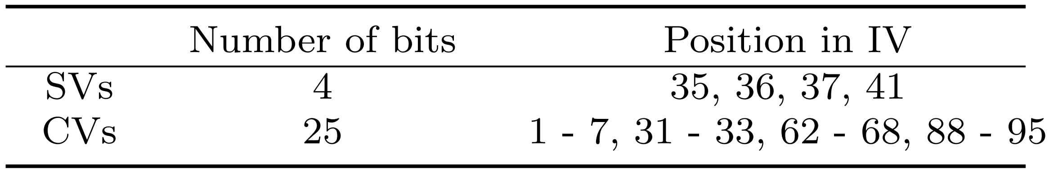
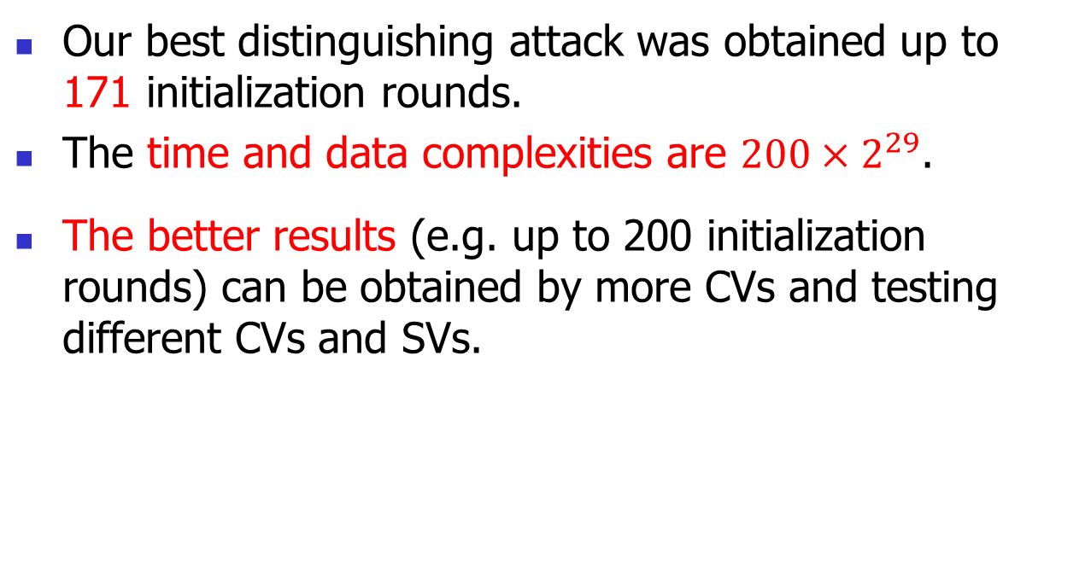
Chosen IV Statistical attack on Grain-128a
Our best distinguishing attack was obtained up to 171 initialization rounds.
The time and data complexities are ${200×2}^{29}$.
The better results (e.g. up to 200 initialization rounds) can be obtained by more CVs and testing different CVs and SVs.
Notes:
(we previously published a distinguishing attack for up to 169 initial rounds of Grain-128a in CyberC 2017 [36]).
The best result was obtained as follows.

Slide 20
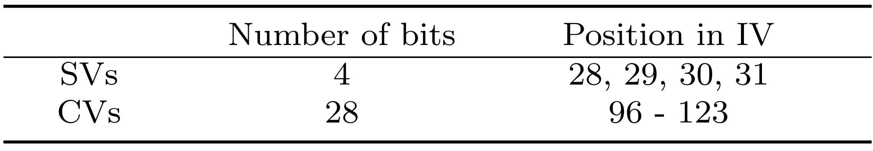
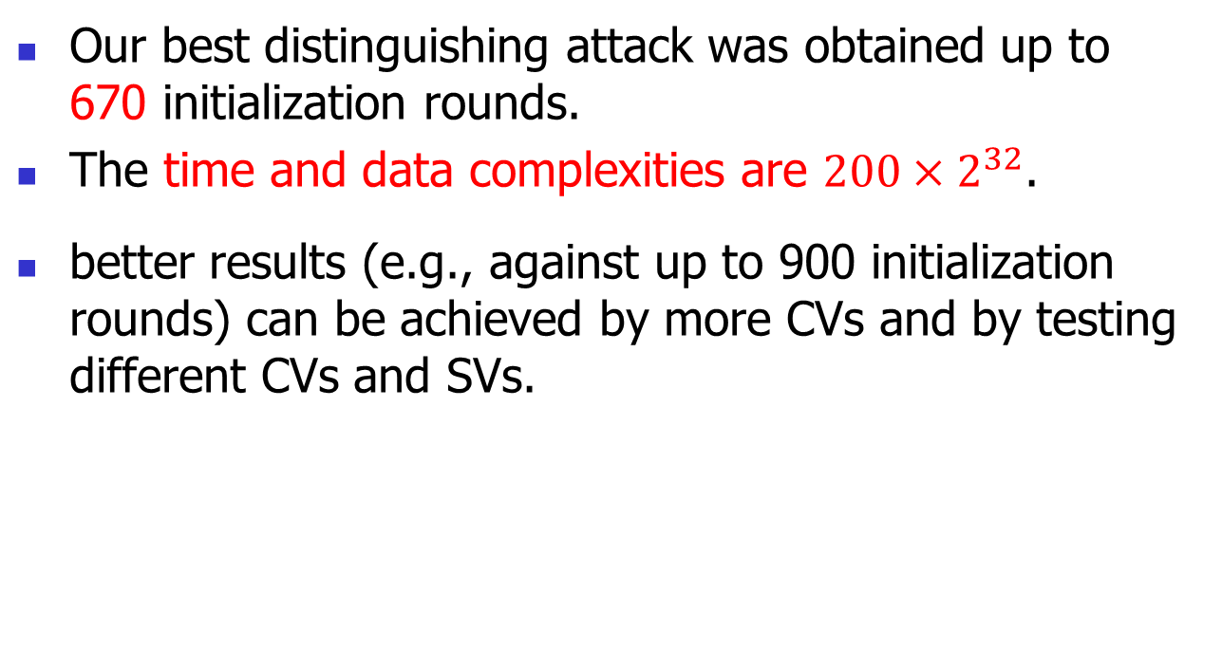
Chosen IV Statistical attack on ACORN-v3
Our best distinguishing attack was obtained up to 670 initialization rounds.
The time and data complexities are ${200×2}^{32}$.
better results (e.g., against up to 900 initialization rounds) can be achieved by more CVs and by testing different CVs and SVs.

Slide 21
Design of Lightweight Stream Ciphers
The storing of key bits for reuse by different IVs is essential for most applications.
Design of stream ciphers with shorter internal state by using key not only in initialization but also in keystream generation.
A new research area in FSE 2015.
The idea let us design small-state stream ciphers.
IoT, WSN, RFID and WBAN

Slide 22
Design of Lightweight Stream Ciphers
it is necessary to store a key in a fixed memory in some applications (RFID systems or SIM cards). It is a valuable idea that the stored key is also used in the design as a part of the internal state. This idea helped us to design an ultra-lightweight stream cipher with a significantly smaller area size.
many devices with limited resource (e.g., wireless sensor network (WSN), Radio-frequency identification (RFID), and Wireless Body Area Network (WBAN)) should be securely connected to the internet.

Slide 23
Fruit family stream ciphers
Sprout stream cipher was proposed as an instance based on the new idea.
Many attacks were published against it.
In 2016, we published Fruit for 80-bit security
few cryptanalysis were published on it
Fortunately, the main structure of Fruit was resistant to key recovery attacks
An improved version of Sprout, Plantlet, was introduced in FSE 2017.
Notes:
A short while after Sprout was introduced, many attacks were published against it.
The design of Fruit was considered and

Slide 24
Fruit family stream ciphers
Fruit-80 is the final version that is easier to implement and secure.
The bottleneck is TMDTO distinguishing attacks.
The attacks might be tolerable depending on the application scenario.
As the attack complexity is lower than that of brute force attack, two countermeasures in the design of Fruit-80 were proposed.

Slide 25
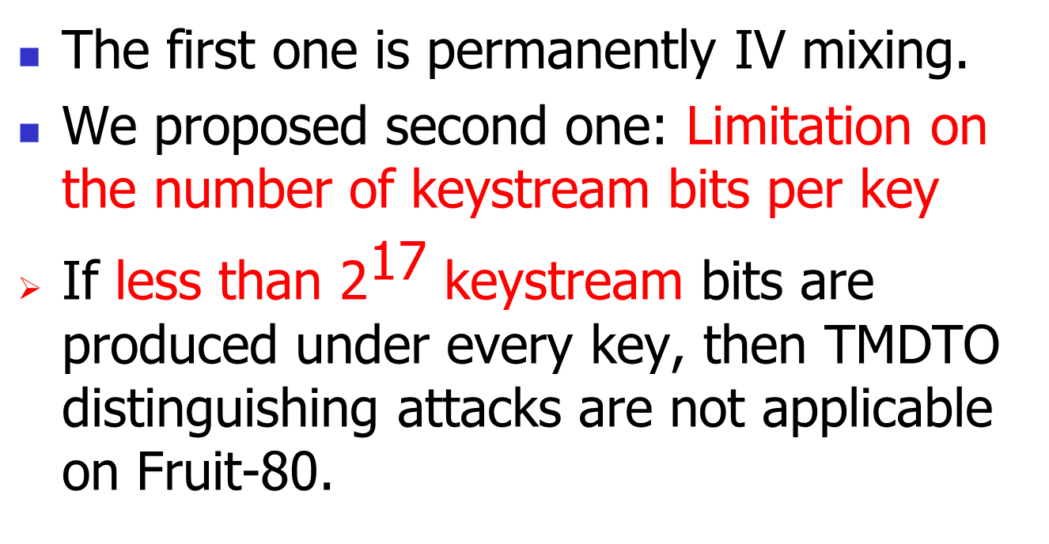
Fruit family stream ciphers
The first one is permanently IV mixing.
We proposed second one: Limitation on the number of keystream bits per key
If less than ${\text{2}}^{\text{17}}$ keystream bits are produced under every key, then TMDTO distinguishing attacks are not applicable on Fruit-80.

Slide 26
Some advantage of Fruit-80
It is better than Plantlet, Sprout, and Lizard ciphers in terms of the initialization speed.
Fruit-80 can be more resistant than Grain-v1 to some attacks such as Cube attacks and related-key attacks.
Unlike the Grain family and Sprout, there is no weak key-IV in Fruit-80.
Notes:
Fruit-80 (similar Grain-v1) needs 160 clocks for initialization, while Plantlet, Sprout, and Lizard need more clocks for initialization.

Slide 27
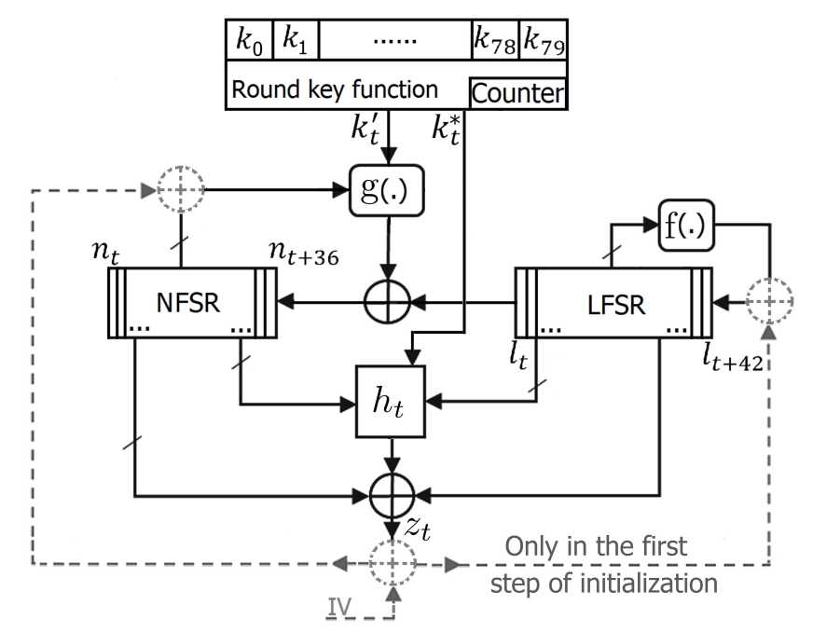
Block Diagram of Fruit-80
Notes:
طول حالت داخلی باید دو برابر امنیت باشد

Slide 28
new ideas in the design of Fruit-80
New round key function
New scheme in the initialization procedure to strengthen against related-key attack
New idea for preventing that LFSR becomes all zeros after the initialization
Increasing the size of LFSR to achieve longer keystream in each loading
New lighter feedback function for NFSR and output function
Involving the key bits directly in output function
Notes:
(the most weaknesses of Sprout are related to the round key function)
(There are weaknesses in the initialization procedure of all members of Grain family and Sprout)
(unlike Grain family and Sprout)
While decreasing the size of the NFSR
(in comparison with Grain-v1 and Sprout)
Involving the key bits directly in the keystream production

Slide 29
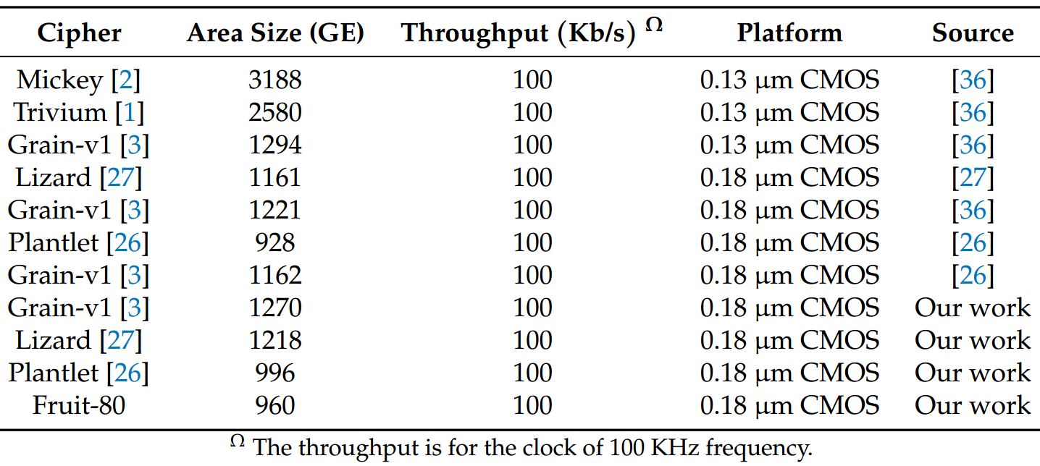
Lightweight Stream Ciphers
The area size of Fruit-80 and some lightweight stream ciphers.
Notes:
These results are expected because the size of the internal states of Fruit-80, Plantlet, Lizard, and Grain-v1 are 87, 101, 121, and 160 bits, respectively.

Slide 30
Fruit-80 Stream cipher
The results show that Fruit-80 is the lightest small-state stream cipher.
The area size of Grain-v1 is about 32% bigger than that of Fruit-80.
Grain-v1 is the lightest candidate in the hardware profile of eSTREAM project.
Notes:
As Grain-v1 is the lightest candidate in the hardware profile of eSTREAM project, it is obvious that design of secure stream ciphers as small as Fruit-80 is attractive.

Slide 31
time-memory-data tradeoff attacks
A distinguishing time-memory-data tradeoff (TMDTO) attack was successfully applied against all SSCs in 2017 by Hamann et al. [1].
They suggested using not only key bits but also initial value (IV) bits continuously in the keystream generation phase to strengthen SSCs against TMDTO attacks.

Slide 32
time-memory-data tradeoff attacks
We show that the proposed SSC remains vulnerable to TMDTO attacks.
We propose constructions, based on storing key or IV bits, that are the first to provide full security against TMDTO attacks.
It is possible to obtain parameters for secure SSCs based on these suggested constructions.

Slide 33
time-memory-data tradeoff attacks
Before the introduction of the first SSC (i.e., Sprout), all of the internal states were volatile memory items.
In SSCs, the internal states consist of volatile memory items and also fixed memory items.
The fixed items can be keys, IVs or both, and they continuously participate in the internal state updating and keystream generation.

Slide 34
time-memory-data tradeoff attacks
SSCs were not as strong as expected against a type of TMDTO attacks, i.e., a TMDTO distinguishing attack.
Accessing IV bits requires extra memory for storing IV bits in some cases, and storing IV bits (unlike key bits) imposes overhead in some cryptosystem applications.

Slide 35
time-memory-data tradeoff attacks
IV bits are usually produced elsewhere in the system (from some parameters of systems, for example from packet numbers) and transferred to the encryption section.
Accessing IV bits requires extra memory in some cryptosystems.
The construction is unrealistic for some applications, and we show that it cannot provide security against TMDTO attacks

Slide 36
time-memory-data tradeoff attacks
IV Length (IVL)
Continuously used IV (CIV)
Continuously used IV Length (CIVL)
Key Length (KL)
Continuously used Key (CK)
State Length (SL) and Volatile State (VS)
Packet length per IV (PIV)
Packet length per Key (PK) and IV (PKI)
Notes:
A section of the IV which is used in the initialization and also continuously in the keystream generation phase (CIV)
A section of the key which is used in the initialization and also continuously in the keystream generation phase (CK)
Internal state length in bits
A section of the internal state which can be changed in every clock (VSi.e., it is volatile)
The maximum number of keystream bits that can be produced per key/IV pair

Slide 37
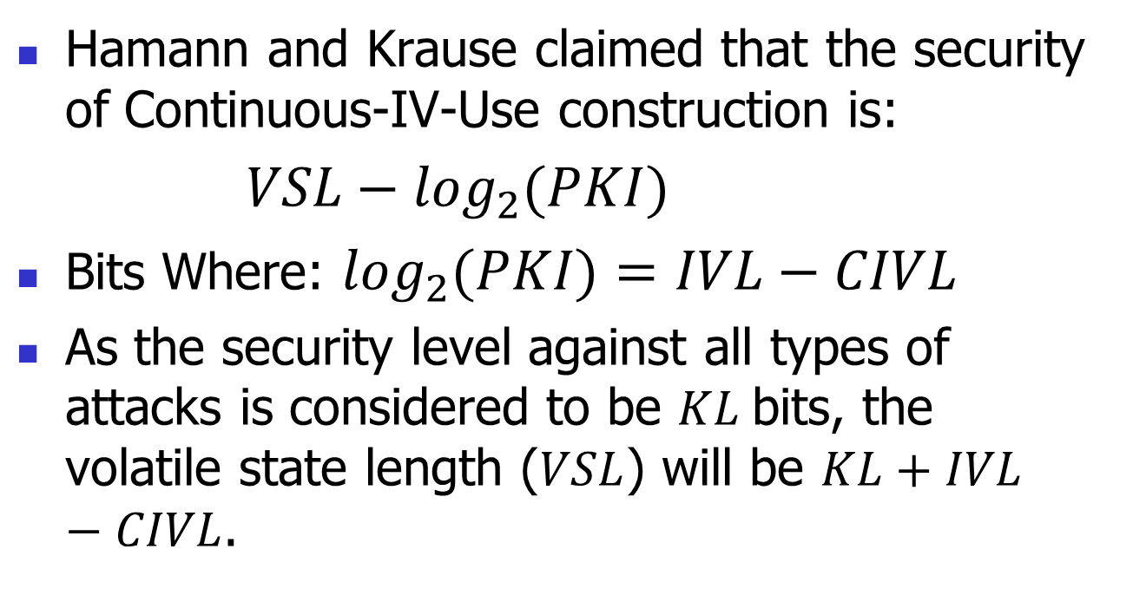
time-memory-data tradeoff attacks
Hamann and Krause claimed that the security of Continuous-IV-Use construction is:
$VSL−\log_{2}{(PKI)}$
Bits Where: $\log_{2}{(PKI)}=IVL−CIVL$
As the security level against all types of attacks is considered to be $KL$bits, the volatile state length ($VSL$) will be $KL+IVL−CIVL$.

Slide 38
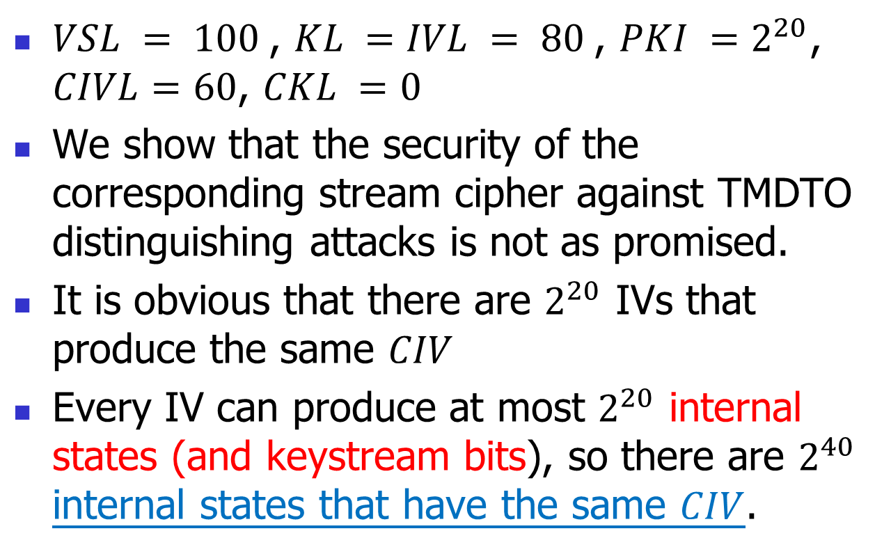
time-memory-data tradeoff attacks
$VSL = 100$, $KL =IVL = 80$, ${PKI =2}^{20}$, $CIVL=60$, $CKL =0$
We show that the security of the corresponding stream cipher against TMDTO distinguishing attacks is not as promised.
It is obvious that there are $2^{20}$ IVs that produce the same $CIV$
Every IV can produce at most $2^{20}$ internal states (and keystream bits), so there are $2^{40}$ internal states that have the same $CIV$.

Slide 39
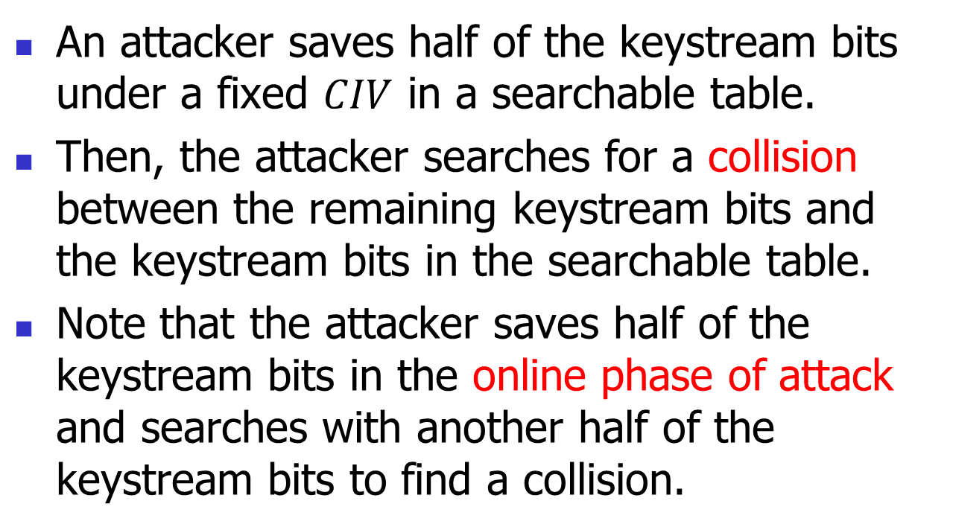
time-memory-data tradeoff attacks
An attacker saves half of the keystream bits under a fixed $CIV$ in a searchable table.
Then, the attacker searches for a collision between the remaining keystream bits and the keystream bits in the searchable table.
Note that the attacker saves half of the keystream bits in the online phase of attack and searches with another half of the keystream bits to find a collision.

Slide 40
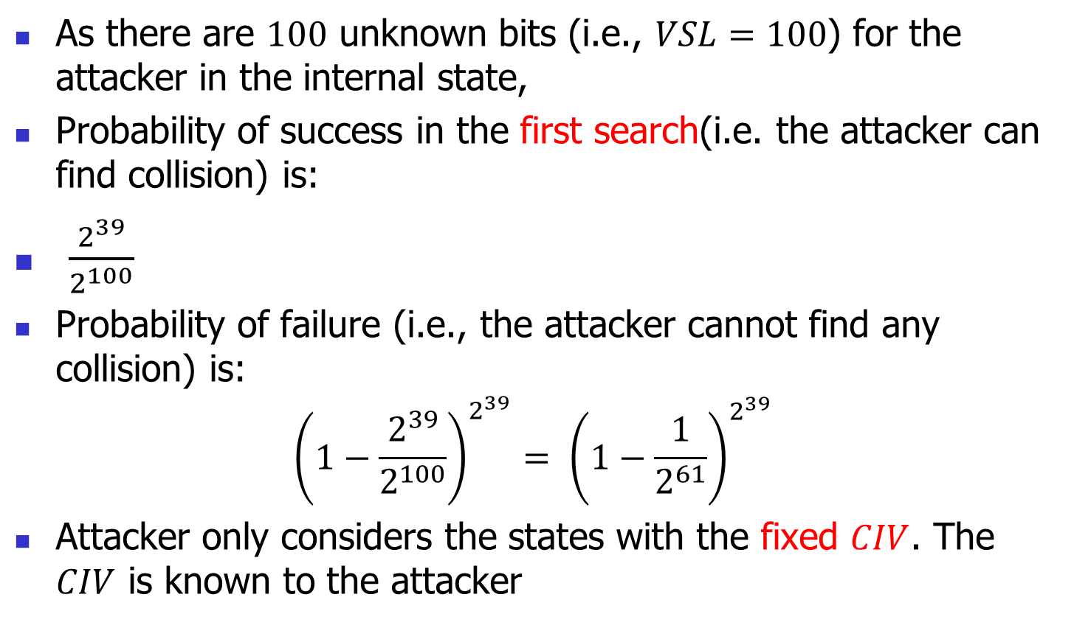
time-memory-data tradeoff attacks
As there are $100$ unknown bits (i.e., $VSL=100$) for the attacker in the internal state,
Probability of success in the first search(i.e. the attacker can find collision) is:
$\frac{2^{39}}{2^{100}}$
Probability of failure (i.e., the attacker cannot find any collision) is:
$${\left(1−\frac{2^{39}}{2^{100}}\right)}^{2^{39}}= {\left(1−\frac{1}{2^{61}}\right)}^{2^{39}}$$
Attacker only considers the states with the fixed $CIV$. The $CIV$ is known to the attacker

Slide 41
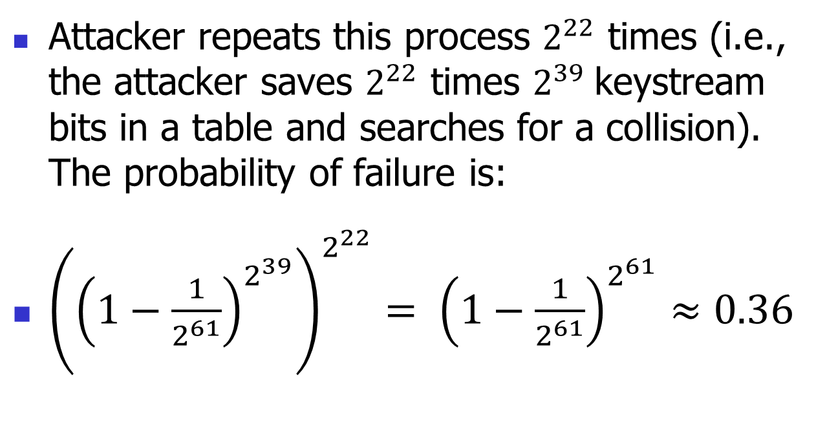
time-memory-data tradeoff attacks
Attacker repeats this process $2^{22}$ times (i.e., the attacker saves $2^{22}$ times $2^{39}$keystream bits in a table and searches for a collision). The probability of failure is:
${\left({\left(1−\frac{1}{2^{61}}\right)}^{2^{39}}\right)}^{2^{22}}= {\left(1−\frac{1}{2^{61}}\right)}^{2^{61}}≈0.36$

Slide 42
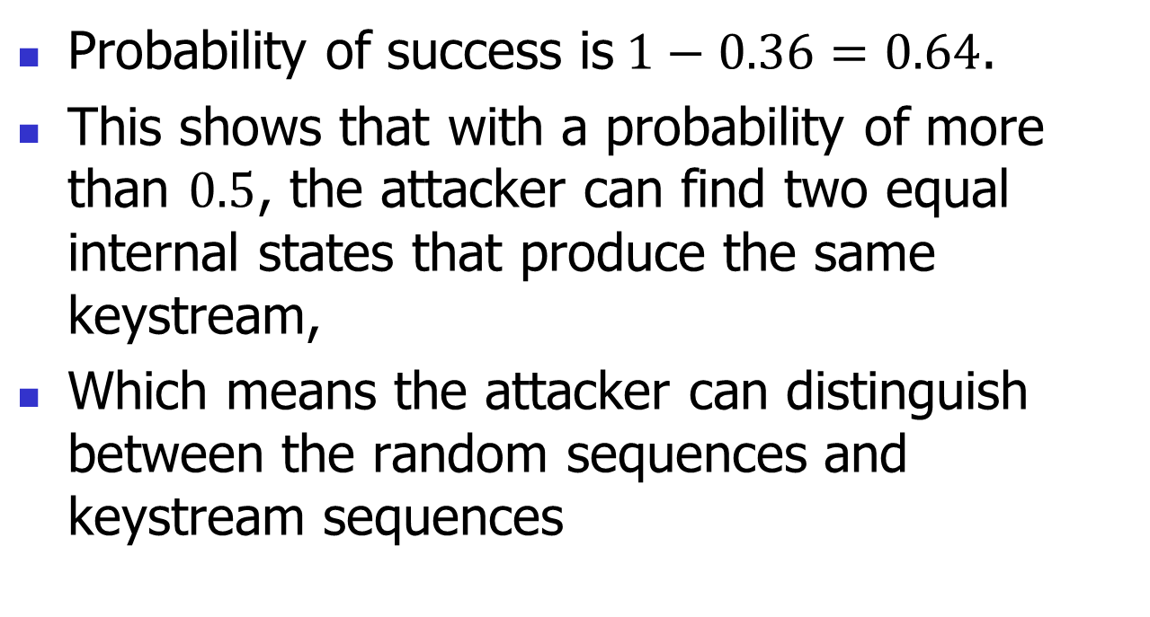
time-memory-data tradeoff attacks
Probability of success is$1−0.36=0.64$.
This shows that with a probability of more than $0.5$, the attacker can find two equal internal states that produce the same keystream,
Which means the attacker can distinguish between the random sequences and keystream sequences

Slide 43
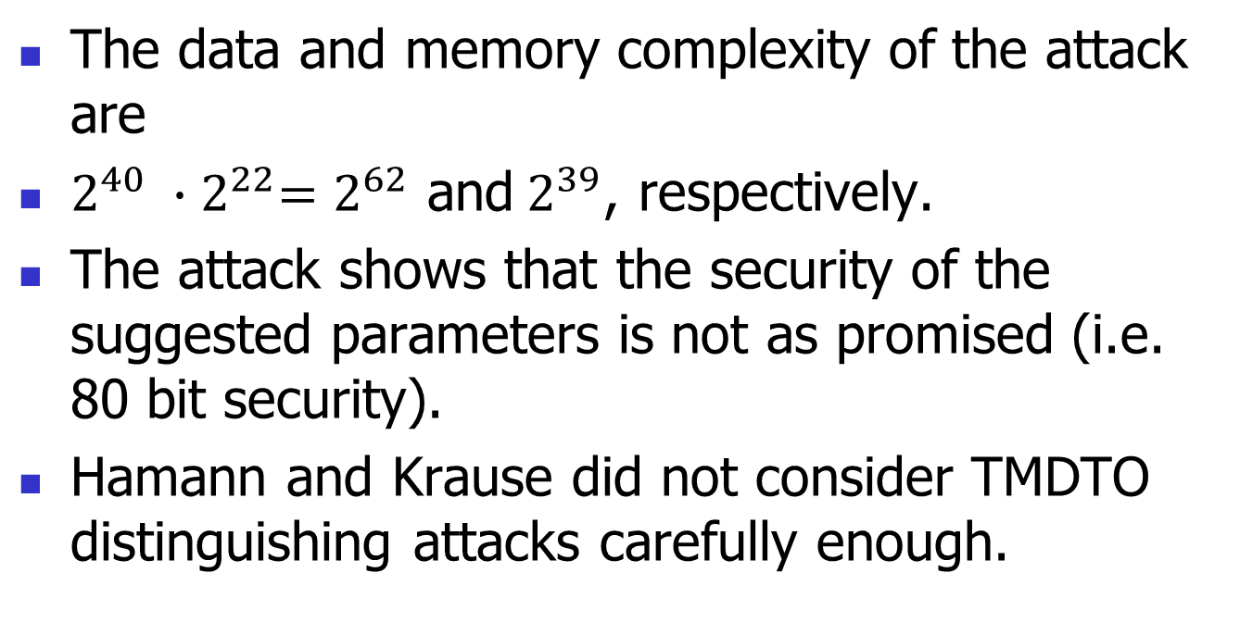
time-memory-data tradeoff attacks
The data and memory complexity of the attack are
$2^{40} ∙{ 2}^{22}=2^{62}$ and$2^{39}$, respectively.
The attack shows that the security of the suggested parameters is not as promised (i.e. 80 bit security).
Hamann and Krause did not consider TMDTO distinguishing attacks carefully enough.

Slide 44
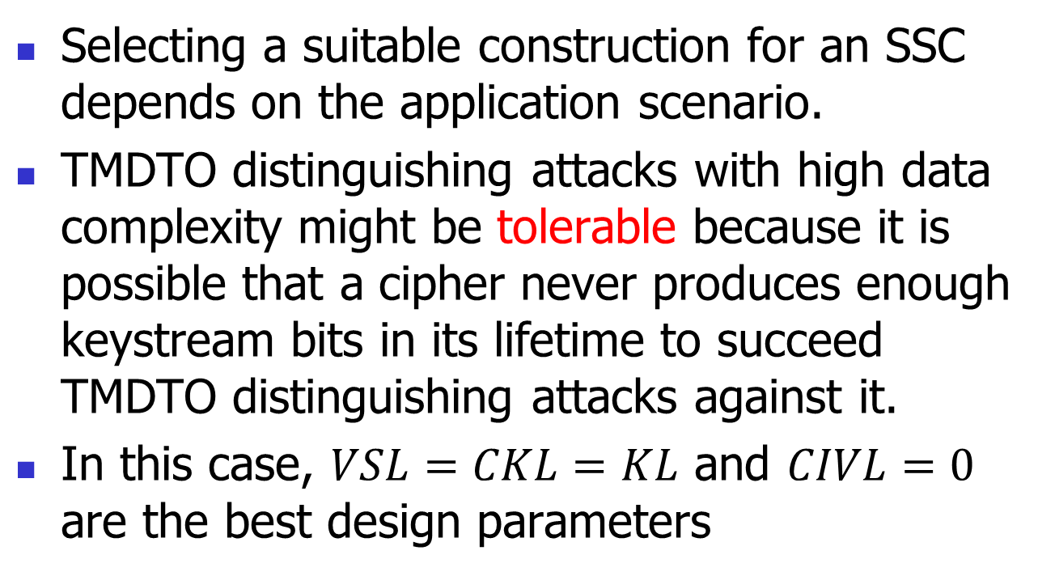
time-memory-data tradeoff attacks
Selecting a suitable construction for an SSC depends on the application scenario.
TMDTO distinguishing attacks with high data complexity might be tolerable because it is possible that a cipher never produces enough keystream bits in its lifetime to succeed TMDTO distinguishing attacks against it.
In this case, $VSL=CKL=KL$ and $CIVL=0$ are the best design parameters

Slide 45
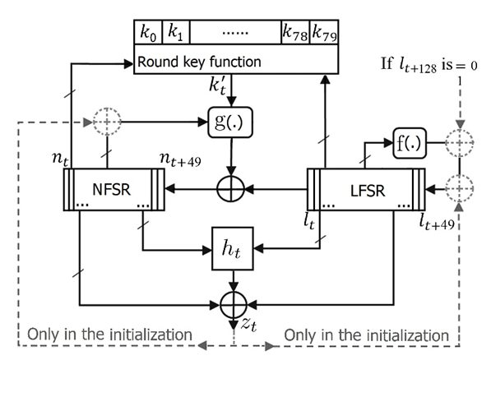
Fruit-F

Slide 46
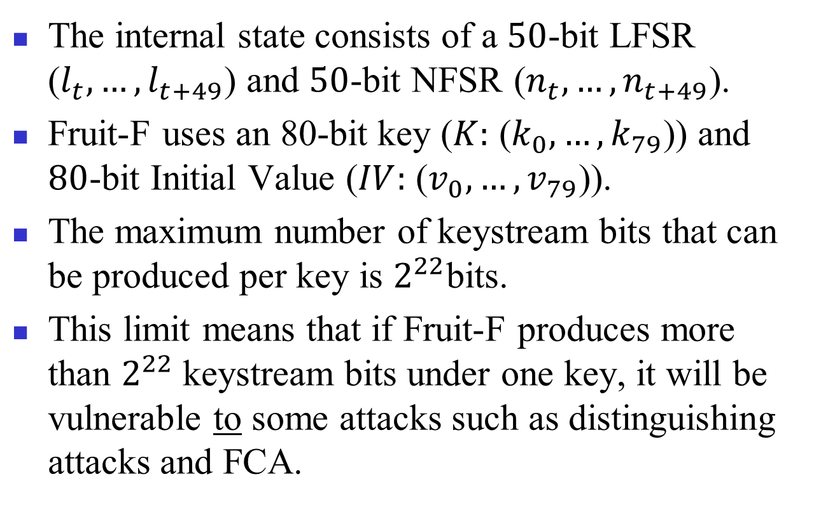
Fruit-F
The internal state consists of a $50$-bit LFSR ($l_{t}, …,l_{t+49}$) and $50$-bit NFSR ($n_{t}, …,n_{t+49}$).
Fruit-F uses an 80-bit key ($K:$ ($k_{0}, …, k_{79}$)) and $80$-bit Initial Value ($IV:$ ($v_{0}, …, v_{79}$)).
The maximum number of keystream bits that can be produced per key is $2^{22}$bits.
This limit means that if Fruit-F produces more than $2^{22}$keystream bits under one key, it will be vulnerable to some attacks such as distinguishing attacks and FCA.

Slide 47
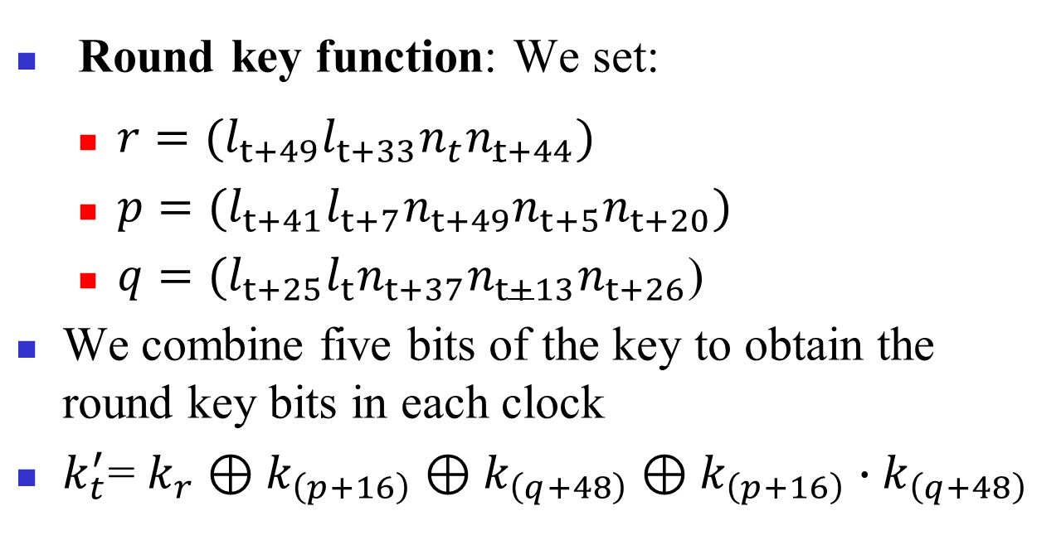
Fruit-F
Round key function: We set:
$r=(l_{t+49}l_{t+33}n_{t}n_{t+44})$
$p=(l_{t+41}l_{t+7}n_{t+49}n_{t+5}n_{t+20})$
$q=(l_{t+25}l_{t}n_{t+37}n_{t+13}n_{t+26}$)
We combine five bits of the key to obtain the round key bits in each clock
$k_{t}^{′}$= $k_{r}⊕k_{\left(p+16\right)}⊕k_{\left(q+48\right)}⊕k_{\left(p+16\right)}∙k_{\left(q+48\right)}$

Slide 48
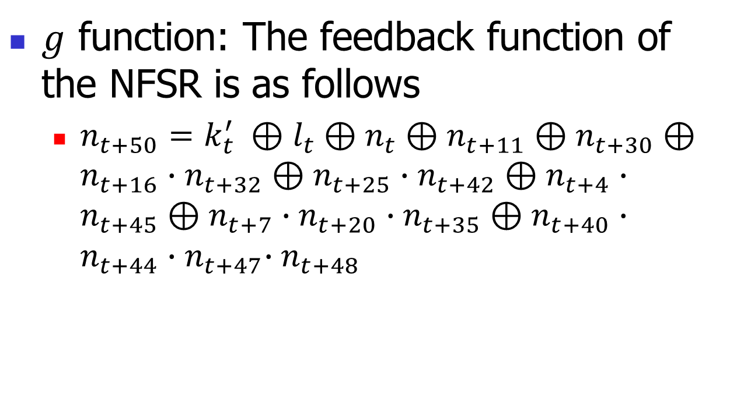
Fruit-F
$g$ function: The feedback function of the NFSR is as follows
$n_{t+50}=k_{t}^{′} ⊕l_{t}⊕n_{t}⊕n_{t+11}⊕n_{t+30}⊕n_{t+16}∙n_{t+32}⊕n_{t+25}∙n_{t+42}⊕n_{t+4}∙n_{t+45}⊕n_{t+7}∙n_{t+20}∙n_{t+35}⊕n_{t+40}∙n_{t+44}{∙n}_{t+47}∙n_{t+48}$

Slide 49
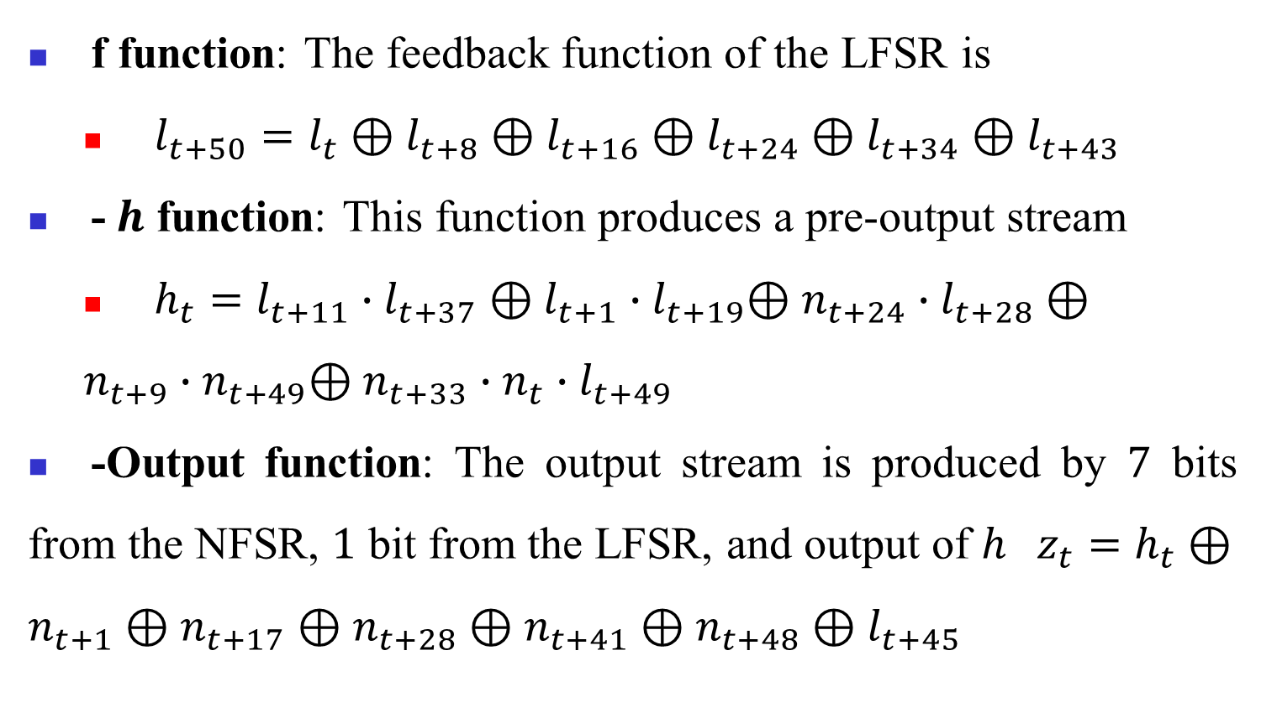
Fruit-F
f function: The feedback function of the LFSR is
$l_{t+50}=l_{t}⊕l_{t+8}⊕l_{t+16}⊕l_{t+24}⊕l_{t+34}⊕l_{t+43}$
-$h$ function: This function produces a pre-output stream
$h_{t}=l_{t+11}∙l_{t+37}⊕l_{t+1}{∙l}_{t+19}⊕n_{t+24}∙l_{t+28}⊕n_{t+9}{∙n}_{t+49}⊕n_{t+33}∙n_{t}∙l_{t+49}$
-Output function: The output stream is produced by $7$ bits from the NFSR, $1$ bit from the LFSR, and output of $h$ $z_{t}=h_{t}⊕n_{t+1}⊕n_{t+17}⊕n_{t+28}⊕n_{t+41}⊕n_{t+48}⊕l_{t+45}$

Slide 50
List of Publications
Journal Papers:
Vahid Amin Ghafari and Honggang Hu, “A new chosen IV statistical distinguishing attack framework to symmetric ciphers, and its application to ACORN-v3 and Grain-128a”, Journal of Ambient Intelligence and Humanized Computing (JAIHC), Springer, SCIE journal, Impact Factor 1.588, GERMANY, (2018).
Vahid Amin Ghafari and Honggang Hu, “Fruit-80: a secure ultra-lightweight stream cipher for constrained environments”, Entropy journal, SCIE journal, Impact Factor 1.821, SWITZERLAND (2018).

Slide 51
List of Publications
Conference Paper:
Vahid Amin Ghafari and Honggang Hu, “A new chosen IV statistical attack on Grain-128a cipher”, CyberC 2017, IEEE conference, CHINA (2017).
Informal publications (IACR Cryptology ePrint Archive ):
Vahid Amin Ghafari and Honggang Hu, Mohammadsadegh Alizadeh. “Necessary conditions for designing secure stream ciphers with the minimal internal states”, 765 (2017).
Vahid Amin Ghafari, Honggang Hu, and Ying Chen, “Fruit-v2: ultra-lightweight stream cipher with shorter internal state”, 355 (2016).

Slide 52
Conclusions
Design Fruit-80
Area size less than 1000 GE
80-bit security (even TMDTO distinguishing attacks)
A new chosen IV statistical distinguishing framework
Distinguishing attacks on Grain-128a and ACORV-v3

Slide 53
Thanks
Any question

Slide 54
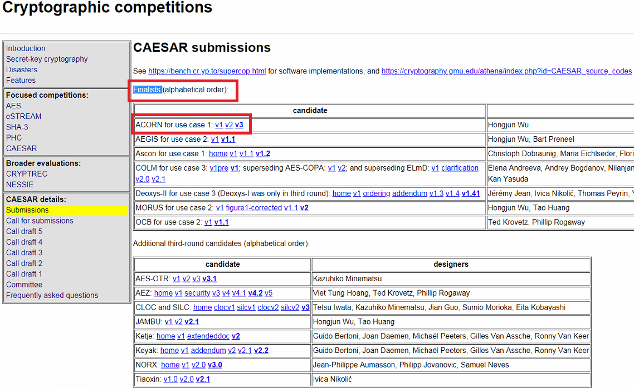
Acorn-v3

Slide 55
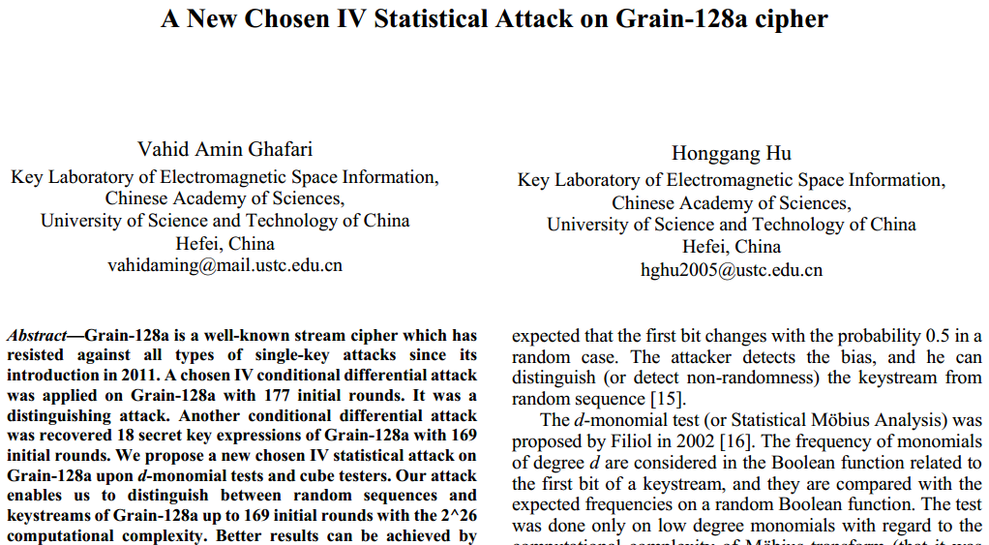
Presented at CyberC2017

Slide 56
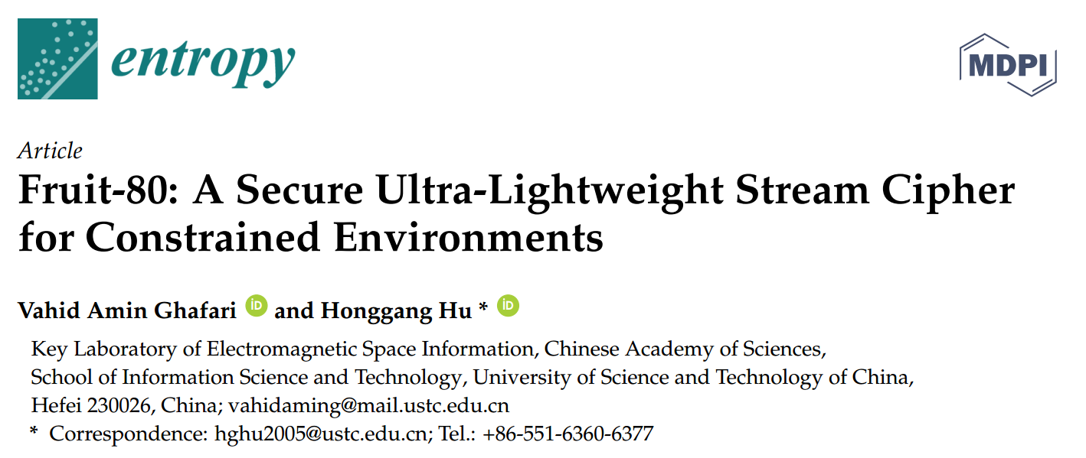
Fruit-80 publication

Slide 57
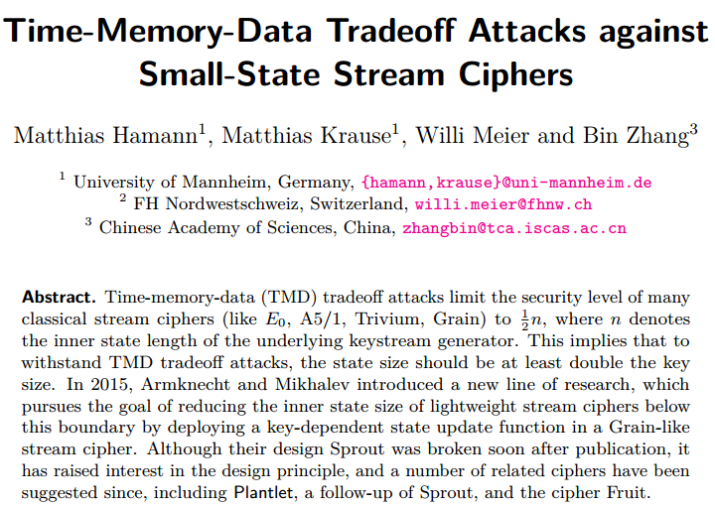
Some attacks on Fruit-v1

Slide 58
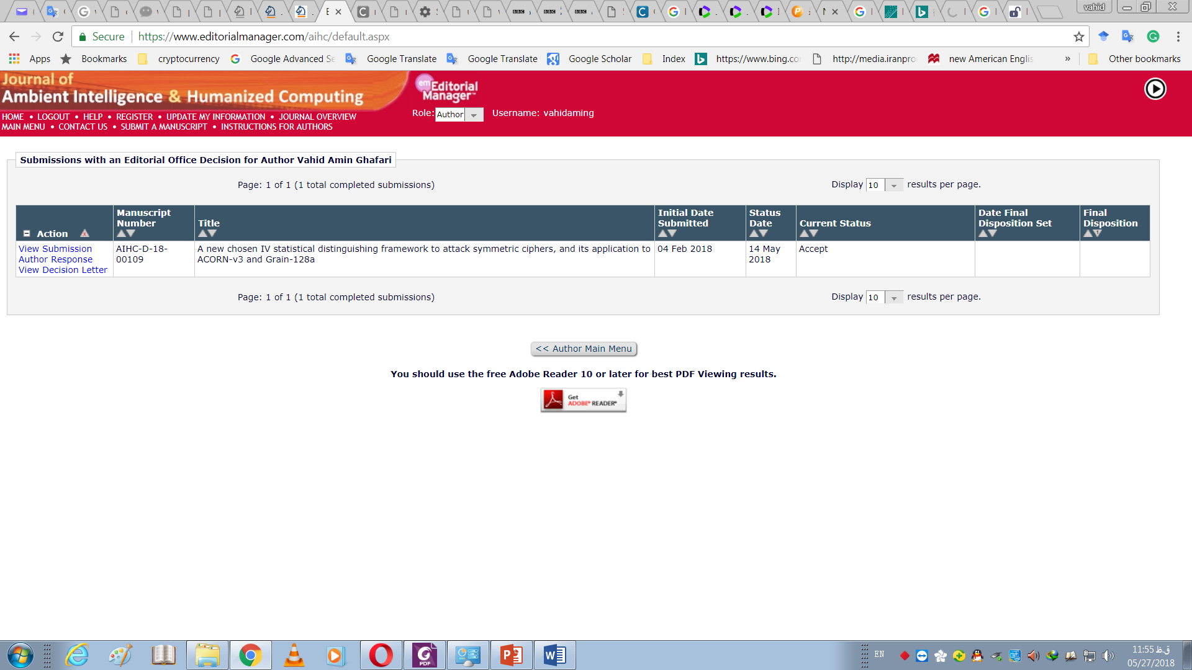

Slide 59
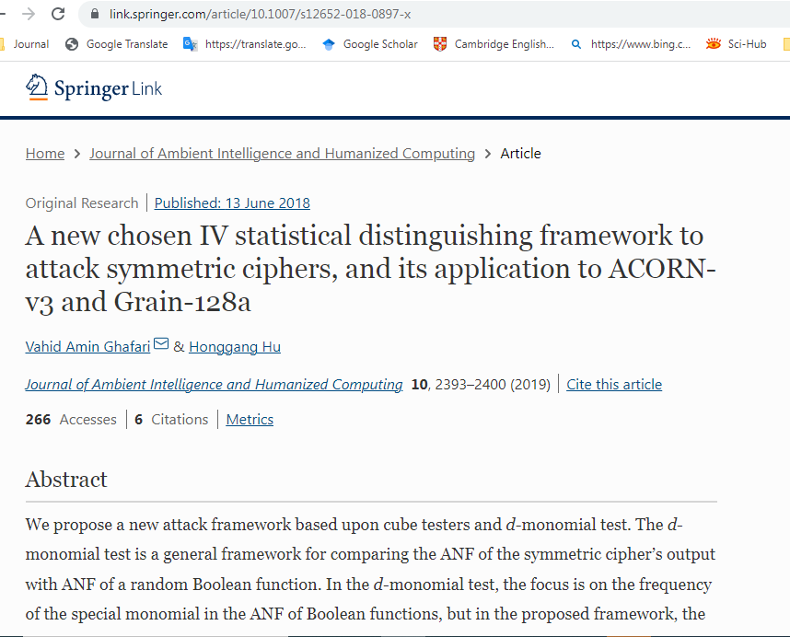

Slide 60
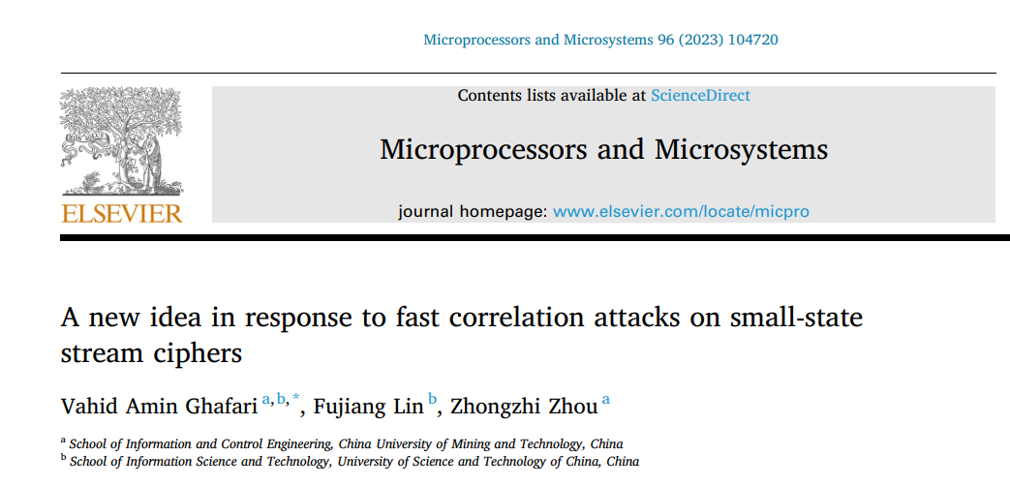
Fruit-F stream cipher

